Slide 1
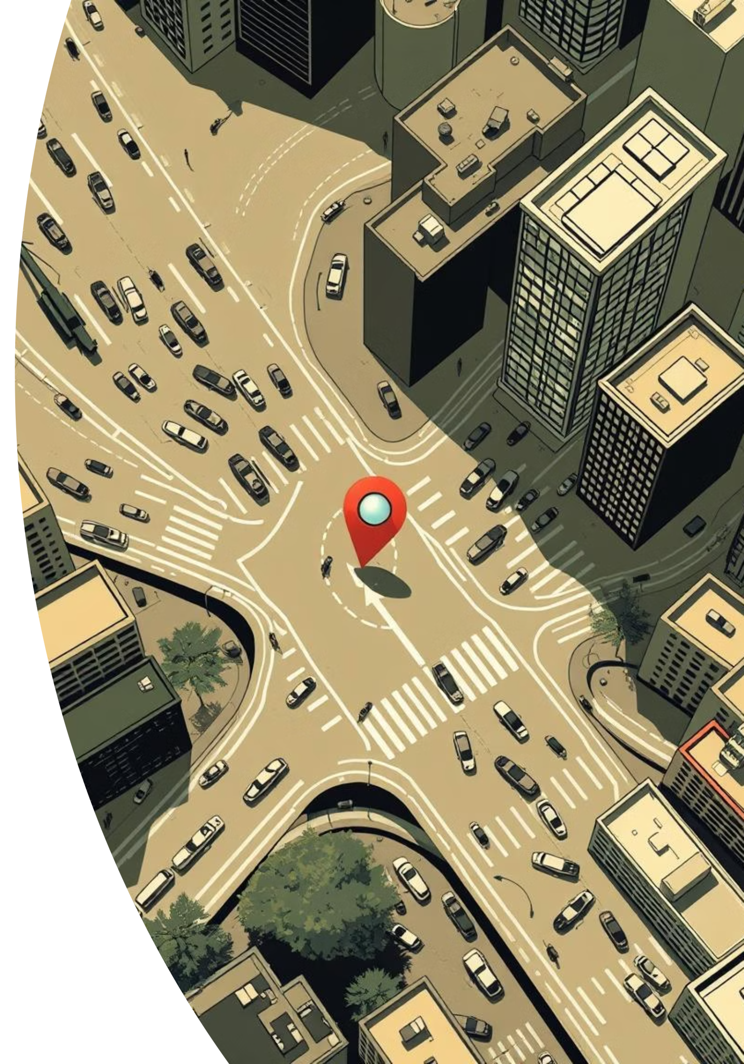
BATO: Biratnagar adaptive Traffic Optimization
“A system that thinks with the city”
Group Members:
Alisha Sigdel
Amsu Thapa
Sara Ghimere Kshetri
Samip Regmi

Slide 2
Problem Statement – Anil’s Story
Roads change suddenly (rain, construction, congestion)
Ambulances arrive late
Delivery services waste time
Vendors lose customers
Existing systems show only fastest route
No reliability or priority-based routing

Slide 3
Facts
The Problem Statement: "In the first 5 months of this year, 191 people died on Koshi's roads. In Biratnagar, a 10-minute commute now takes 30 minutes. We are losing lives and productivity to a system that doesn't adapt."
The E-Rickshaw Justification: With 50,000 daily commuters using e-safaris, they are the backbone of Biratnagar.

Slide 4
Existing Services For Biratnagar
Nagarik App :Driving License ,Traffic Fine
DOTM: Access to Vehcile bluebook
Ride Sharing Apps: booking transportation
Traffic Police Nepal App
What’s Lacking?
Real Time flow/regulation
Dedicated GPS based Traffic Flow
Existing App use old Zonal System

Slide 5
Why We Chose This Solution
One route cannot serve all users
Different priorities for ambulance, vendor, delivery
Uses real-time Data
Practical for areas like Bargachi

Slide 6
How the System Works
GPS data
Traffic police updates
Construction reports
Citizen feedback
Dynamic decision-making
Role based access Control

Slide 7

Key Features
Real-time route updates
User-based modes
Road reliability score
Multiple route options
Decision explanation

Slide 8

Tools Used
ExpressJs
Socket
Openleaflet map

Slide 9

System Demo (Concept)
Select user type
System analyzes conditions
Routes ranked by priority
User chooses best option

Slide 10
Why People Will Use It + Algorithm
Improves emergency response
Reduces confusion
Saves time and fuel
Algorithm:
1. Data collection
2. Priority weighting
3. Route ranking
4. Continuous updates

Slide 11
Conclusion
Cities are dynamic
Static systems fail
Adaptive systems succeed
BATO turns traffic chaos into intelligent decisions

